Slide 1
Recognize Human Activities from Partially Observed Videos
Anuroop Kakkirala Praneeth AS

Slide 2
Aim of the Project
To recognize human activities from partially observed videos and predicting the unobserved subsequence in the video.
Two possibilities:
1) An Unobserved subsequence is at the end of the video.
2) It may occur at any time by yielding a temporal gap in the video

Slide 3



Full Observation
Missing Observation
At the end.
Gap filling

Slide 4
Problem Formation: 1) For a Fully Observed Video
Given a fully observed video O[1 : T] of length T, O[t] indicates the frame at time t.
Goal is to classify the video O[1 : T] into one of P activity classes {A = {Ap}, p = 1, . . . ,P}.
Human actions - sequence of simple actions - contain different spatiotemporal features. Divide uniformly into M different segments O(ti−1 : ti] where ti = i*T/M, i th stage of activity i = 1, . . . , M.

Slide 5
Formation continued..
P(Ap|O[1 : T]) ∝ ∑ i|0 to M P(Ap,(ti−1,ti]|O[1 : T]) ∝ ∑i|0 to M P(Ap,(ti−1,ti])P(O[1 : T]|Ap,(ti−1,ti]).
P(Ap,(ti−1,ti]) = prior of stage i of activity Ap
P(O[1 : T]|Ap,(ti−1,ti]) = observation likelihood given activity class Ap.
p∗ = arg max∑i|0 to M P(Ap,(ti−1,ti])P(O[1 : T]|Ap,(ti−1,ti])
p* is index of recognized activity.

Slide 6
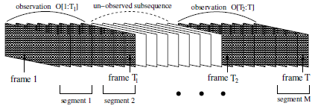
2) For a Partially Observed Video
Partially observed video - O[1 : T1] ∪ [T2 : T], where frames O(T1 : T2) are missing.
T1 is always the last frame of a segment and T2 is always the first of another segment.

Slide 7
Formation continued..
Posterior probability that an activity is presented in this partially observed video
P(Ap|O[1 : T1] ∪ [T2 : T]) ∝ w1 ∑ i|ti≤T1 P(Ap,(ti−1,ti]|O[1 :T1]) + w2 ∑i|ti−1≥T2 P(Ap,(ti−1,ti]|O[T2 : T])
w1= T1/(T1+T-T2+1) , w2= T-T2+1/(T1+T-T2+1)
p∗ = arg max P(Ap|O[1 : T1] ∪ O[T2 : T])
Where P(Ap|O[1 : T1] ∪ O[T2 : T]) can be calculated as above.

Slide 8
Likelihood calculation
Compare O[1 : T1] with the i th segment of all the training videos.
Each segment of a video, use the bag-of-visual-words technique to organize its spatiotemporal features into a fixed-dimensional feature vector.
- - feature(row) vector after applying bag-of-visual-words techniques to ith segment of the nth training video
- feature for stage i in O[1 : T1]

Slide 9
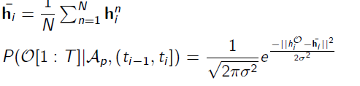
Likelihood calculation continued..

